Slide 1

Chapter 2 ~ Digital Image Fundamentals
Heaven’s Light is Our Guide
Department of Computer Science & Engineering
Rajshahi University of Engineering & Technology, Rajshahi-6204, Bangladesh.
S. M. Mahedy Hasan
Assistant Professor, Dept. of CSE
RUET, Rajshahi-6204, Bangladesh.
Notes:
‹#›
*

Slide 2
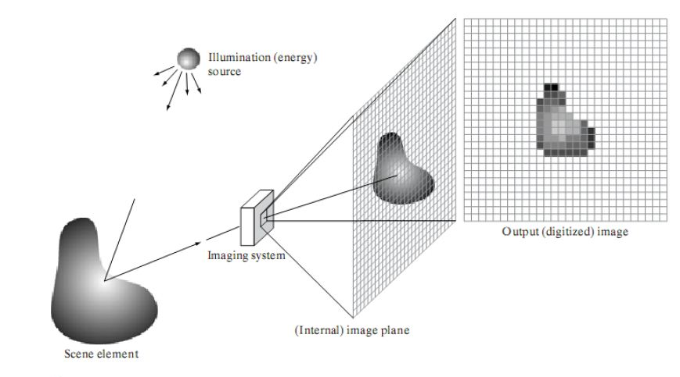
Image Sensing and Acquisition
Most of the images in which we are interested are generated by the combination of an “illumination” source and the reflection or absorption of energy from that source by the elements of the “scene” being imaged.
Depending on the nature of the source, illumination energy is reflected from, or transmitted through, objects.
An example in the first category is light reflected from a planar surface. An example in the second category is when X-rays pass through a patient’s body for the purpose of generating a diagnostic X-ray film.
‹#›
Digital Image Fundamentals
*
Notes:
‹#›

Slide 3
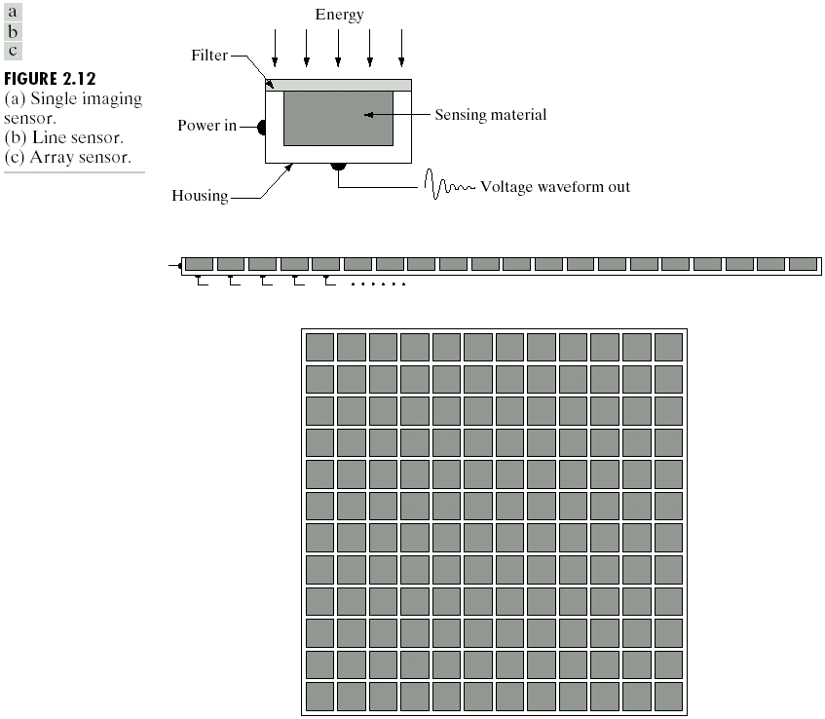
Image Sensing and Acquisition
Single Sensor
‹#›
Digital Image Fundamentals
*
Notes:
‹#›

Slide 4
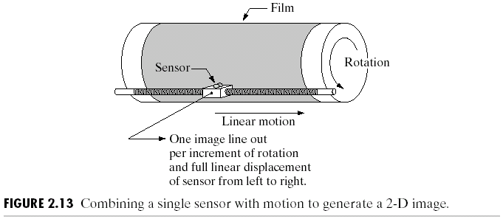
Image Sensing and Acquisition
Single Sensor
In order to generate a 2-D image using a single sensor, there has to be relative displacements in both the x- and y-directions between the sensor and the area to be imaged.
‹#›
Digital Image Fundamentals
*
Notes:
‹#›

Slide 5
Image Sensing and Acquisition
Single Sensor
- Other similar mechanical arrangements use a flat bed, with the sensor moving in two linear directions.
- These types of mechanical digitizers sometimes are referred to as microdensitometers.
‹#›
Digital Image Fundamentals
*
Notes:
‹#›

Slide 6


Image Sensing and Acquisition
Another example of imaging with a single sensor places a laser source coincident with the sensor. M
Moving mirrors are used to control the outgoing beam in a scanning pattern and to direct the reflected laser signal onto the sensor.
This arrangement can be used also to acquire images using strip and array sensors.
‹#›
Digital Image Fundamentals
*
Notes:
‹#›

Slide 7
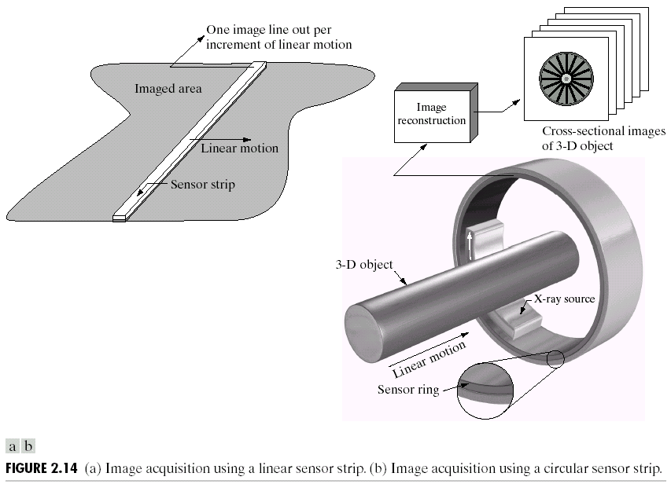
Image Sensing and Acquisition
Sensor Strip (Linear)
a | b
a) Linear Sensor b) Image acquisition using a linear sensor strip
‹#›
Digital Image Fundamentals
*
Notes:
‹#›

Slide 8
Image Sensing and Acquisition
Sensor Strip (Linear)
- Sensor strips mounted in a ring configuration are used in medical and industrial imaging to obtain cross-sectional (“slice”) images of 3-D objects.
Computerized axial tomography (CAT) imaging
Magnetic resonance imaging (MRI)
Positron emission tomography (PET).
‹#›
Digital Image Fundamentals
*
Notes:
‹#›

Slide 9
Image Sensing and Acquisition
Sensor Array
Its key advantage is that a complete image can be obtained by focusing the energy pattern onto the surface of the array.
Motion obviously is not necessary.
‹#›
Digital Image Fundamentals
*
Notes:
‹#›

Slide 10
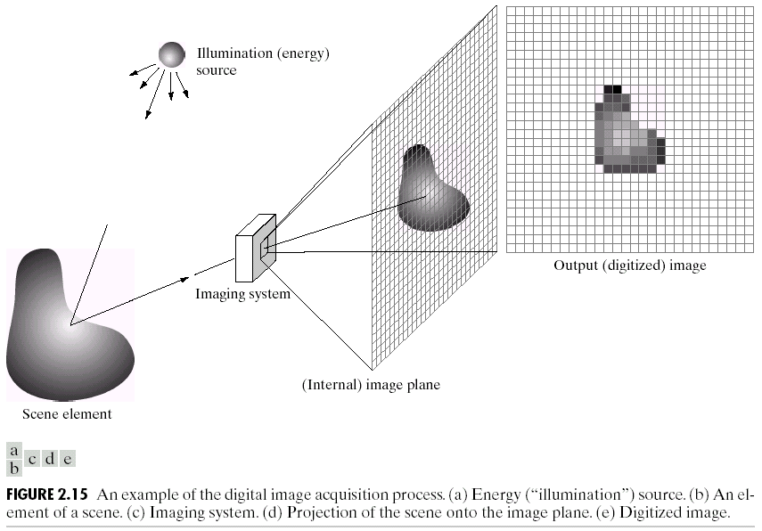
Image Sensing and Acquisition
The energy from an illumination (a) source being reflected from a scene (b).
‹#›
Digital Image Fundamentals
*
Notes:
‹#›

Slide 11
Image Sensing and Acquisition
The first function performed by the imaging system (c) is to collect the incoming energy and focus it onto an image plane.
‹#›
Digital Image Fundamentals
*
Notes:
‹#›

Slide 12
Image Sensing and Acquisition
The illumination is light, the front end of the imaging system is an optical lens that projects the viewed scene onto the lens focal plane (d),
‹#›
Digital Image Fundamentals
*
Notes:
‹#›

Slide 13
Image Sensing and Acquisition
-The sensor array, which is coincident with the focal plane, produces outputs proportional to the integral of the light received at each sensor.
-Digital and analog circuitry sweep these outputs and convert them to an analog signal, which is then digitized by another section of the imaging system. (e).
‹#›
Digital Image Fundamentals
*
Notes:
‹#›

Slide 14




Image Sensing and Acquisition
A Simple Image Formation Mode
- we denote images by two-dimensional functions of the form f(x,y). f(x,y) must be nonzero and finite; that is,
-The function f(x,y) may be characterized by two components:
the amount of source illumination incident on the scene being viewed, and
the amount of illumination reflected by the objects in the scene.
Appropriately, these are called the illumination and reflectance components and are denoted by i(x,y) and r(x,y) respectively.
The two functions combine as a product to form:
‹#›
Digital Image Fundamentals
*
Notes:
‹#›

Slide 15


Image Sensing and Acquisition
A Simple Image Formation Mode
0<r(x,y)<1 indicates that reflectance is bounded by 0 (total absorption) and 1 (total reflectance).
The nature of i(x,y) is determined by the illumination source, and is determined by the characteristics of the imaged objects.
‹#›
Digital Image Fundamentals
*
Notes:
‹#›

Slide 16
Image Sensing and Acquisition
A Simple Image Formation Model
- It is noted that these expressions also are applicable to images formed via transmission of the illumination through a medium, such as a chest X-ray.
- In this case, we would deal with a transmissivity instead of a reflectivity function.
‹#›
Digital Image Fundamentals
*
Notes:
‹#›

Slide 17
Thank You ☺
‹#›
Digital Image Fundamentals
*

